Slide 1










Deep Learning and
Sentiment Analysis
for Stock Price Forecasting
Amber Lee, Cindy Zhang, Hejia Zhang, Wafer Hsu
Oretha Domfeh (TA)

Slide 2
Introduction
Background
New technology and data science approaches in financial market forecasting
Most of the well-known investment methodologies are quantitative analysis
Ways to improve financial investment forecasting
Objective
Employ comprehensive qualitative and qualitative approach to create a predictive model
Historical Stock Trends & Real-Time News Data
Harness the power of ubiquitous data to empower investors of all scales in making more accurate and effective investment decisions

Slide 3
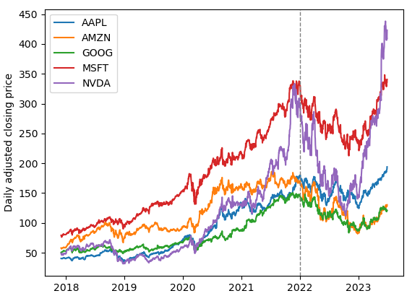
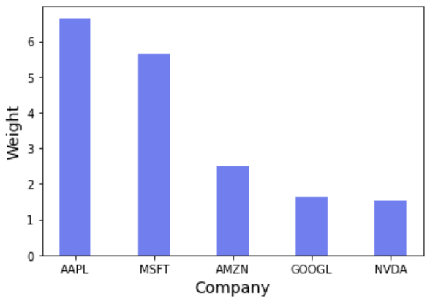





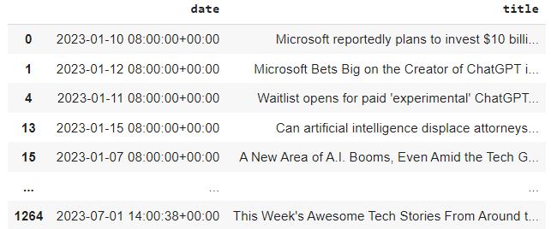
Datasets
Stock Price
S&P 500 Tickers
Retrieved 2018-2023 daily adjusted closing price from Quandl
Selected top five S&P 500 companies by weight: Apple, Amazon, Google, Microsoft, and Nvidia.
News Headlines
Web-Scraping 2018-2023 news headlines from Google News

Slide 4
Data Preparation
&
Exploratory Data Analysis
Sentiment Analysis
Fama-French 5 Factors Model
Missing Values
EDA

Slide 5
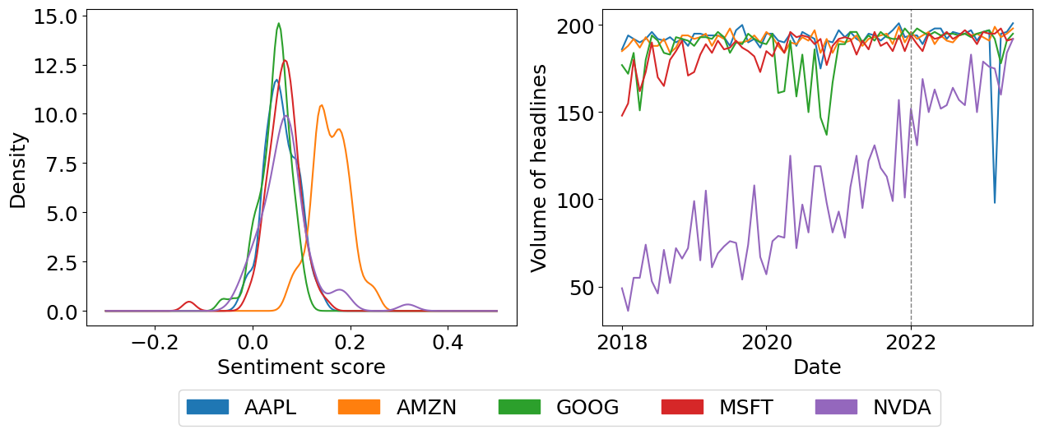
Sentiment Analysis
How to Optimize Job Listings for Google Search
Com | 0.4939 | Neg | 0.0 | Neu | 0.714 | Pos | 0.286
Top Google recruiter: Google uses this 'shocking' strategy to hire the best employees
Com | 0.7184 | Neg | 0.0 | Neu | 0.667 | Pos | 0.333
If you invested $1,000 in Google 10 years ago, here’s how much you’d have now
Com | 0.0 | Neg | 0.0 | Neu | 1.0 | Pos | 0.0
When It Comes to Gorillas, Google Photos Remains Blind
Com | -0.4019 | Neg | 0.231 | Neu | 0.769 | Pos | 0.0
Changing Country Codes With Google
Com | 0.0 | Neg | 0.0 | Neu | 1.0 | Pos | 0.0
Used Natural Language Processing (NLP) to transforms large-scaled unstructured text data into structured and quantitative measurements of the sentimental opinions.
VADER model from NLTK package
Sentiments include positive, neutral, negative, and compound
Distribution of sentiment analysis score by ticker
Included one additional covariate: the total number of articles per day

Slide 6


Fama-French 5 Factors
SMB
RMW
Statistical model designed in 1992 by Eugene Fama and Kenneth French to describe stock returns
HML
CMA
MKT
The Linear Regression model we applied:
The 5 factors include:
Market (MKT): excess market return
Size (SMB): excess return of small v.s. large companies
Value (HML): excess return of high book/market versus low book/market companies (value stocks v.s. growth stocks)
Profitability (RMW): the difference between returns of firms with high/low profitability
Investment (CMA): difference in returns between high/low investment firms
𝑅𝑓𝑡 − 𝑅𝐹𝑡 = β0 + β1𝑀𝐾𝑇 + β2𝑆𝑀𝐵 + β3𝐻𝑀𝐿 + β4 𝑅𝑀𝑊 + β5 𝐶𝑀𝐴 + ε
Fama–French five-factor Model
Data Preparation
We employed a rolling linear regression approach over a 100-trading-day period

Slide 7
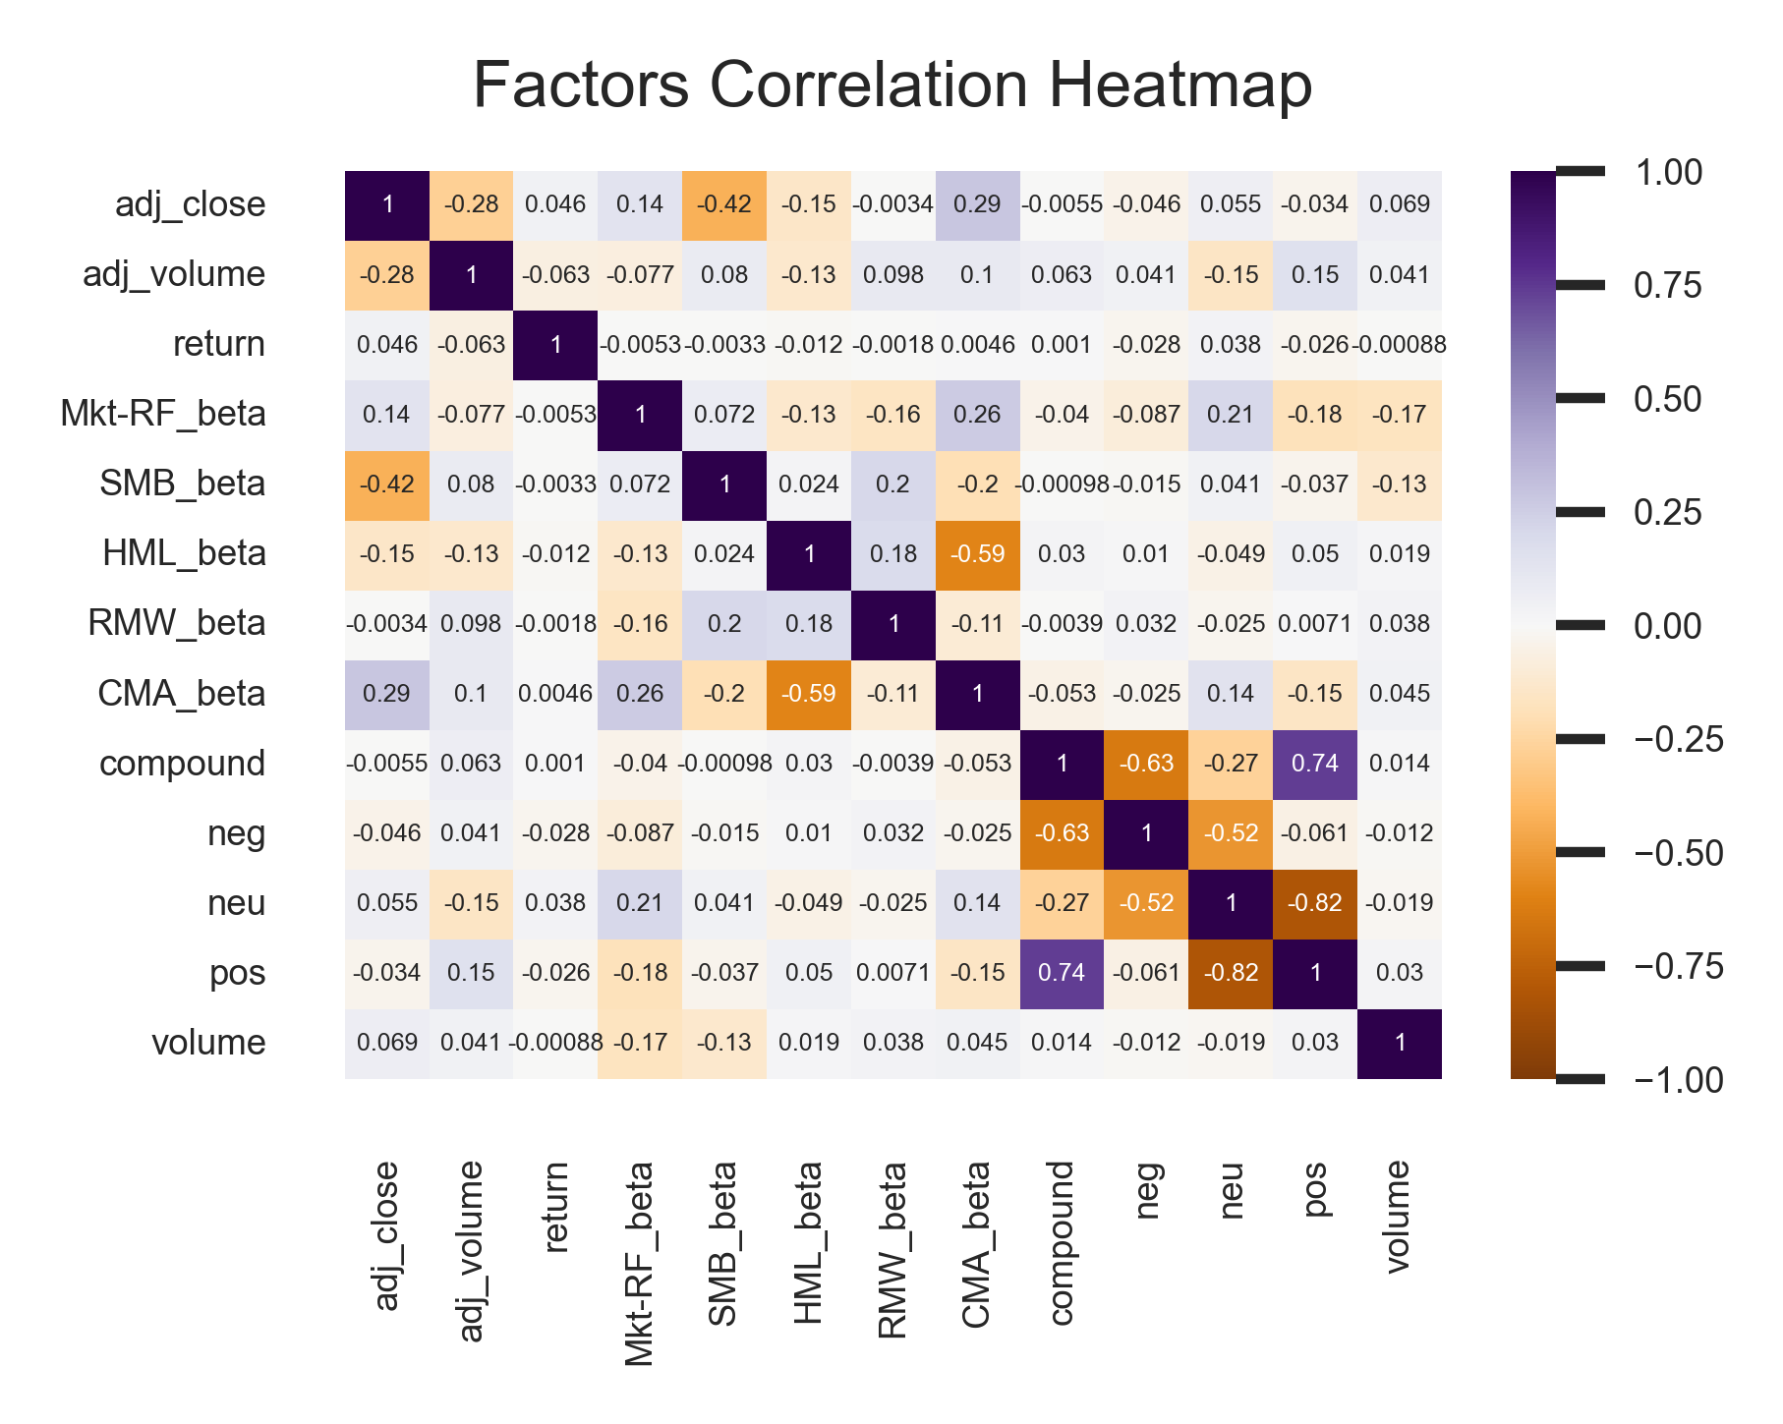
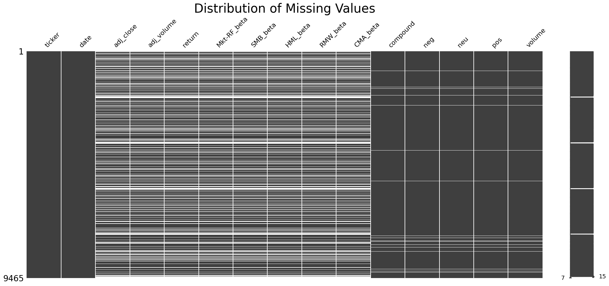
Exploratory Data Analysis
Inputs:
Fama-French Five-Factors model
Sentiment Scores Financial News Headlines
Output:
Adjusted Stock Closing Prices
Missing values?
News Headlines: for days without any news articles, imputed by the last sentiment scores, and volume = 0
Stock Prices: utilize the stock price from the previous trading day to fill in the missing stock prices

Slide 8
Data Modeling
Train / Test Split:
Training: January 10, 2018 to December 31, 2021
Testing: January 1, 2022 to June 30, 2023
Models:
Jan 2018 - Jun2023 | Linear Regression Random Forest | Univariate LSTM (Baseline Model) | Multivariate LSTM (Proposed Model)
Stock Closing Prices | V | V | V
Fama-French | V | - | -
Sentiment Scores | V | - | V
News Volume | V | - | V

Slide 9
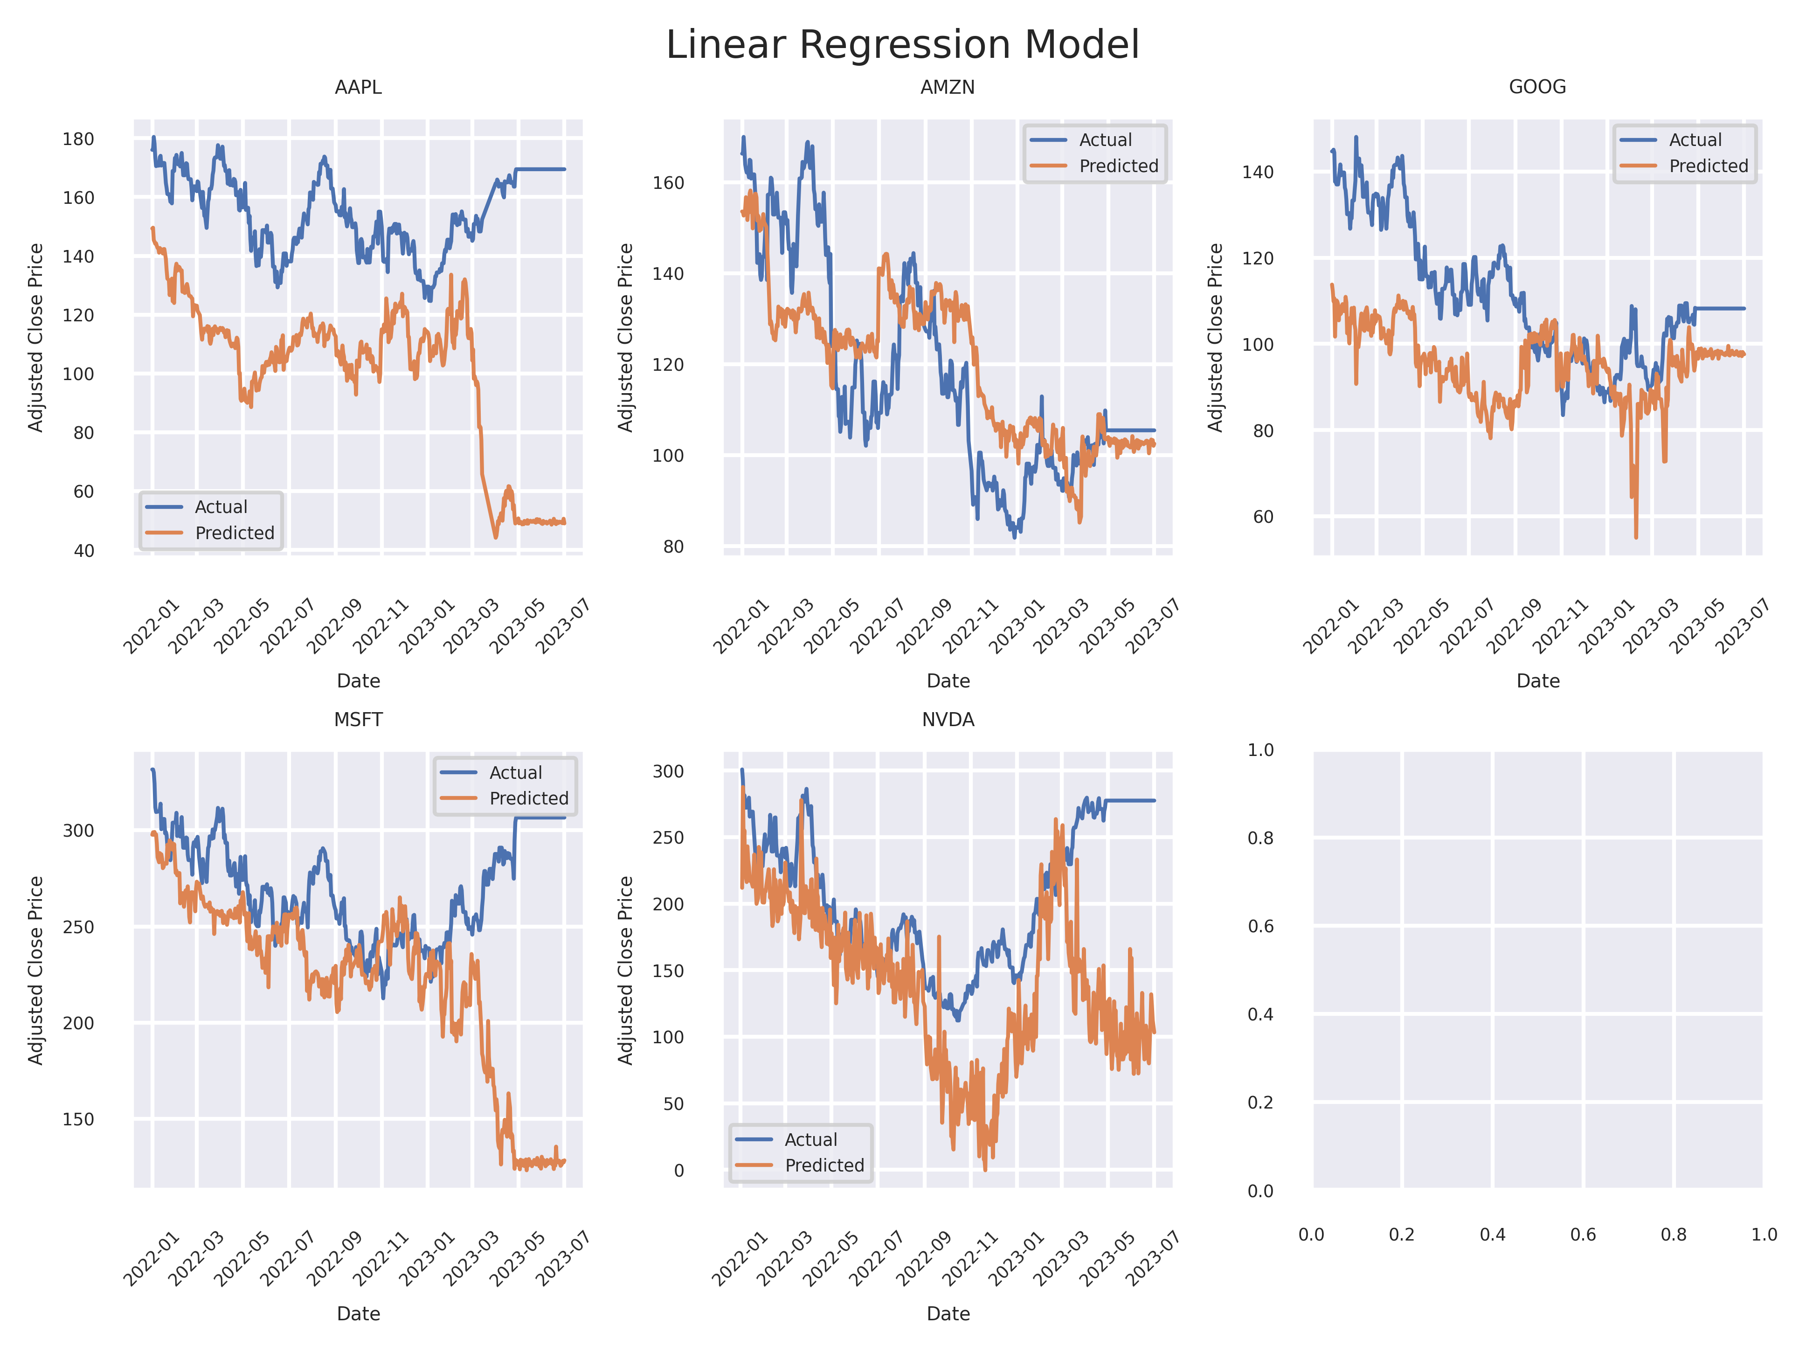
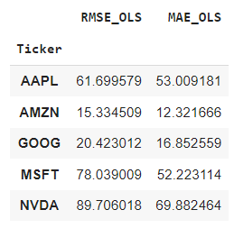
Linear Regression

Slide 10
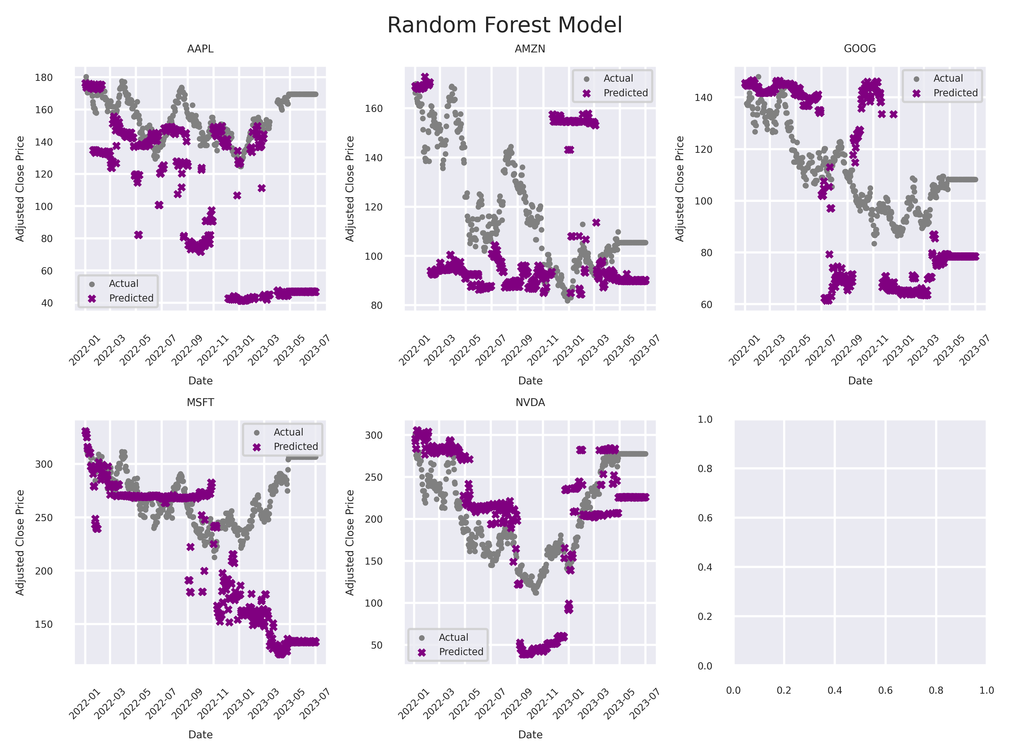
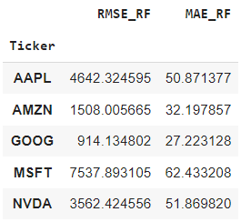
Random Forest

Slide 11
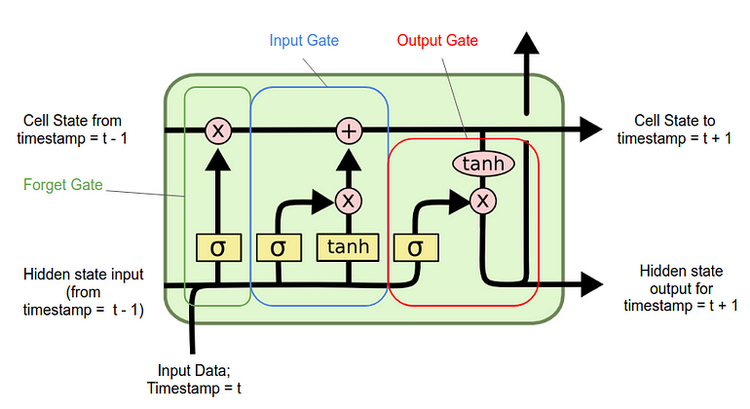
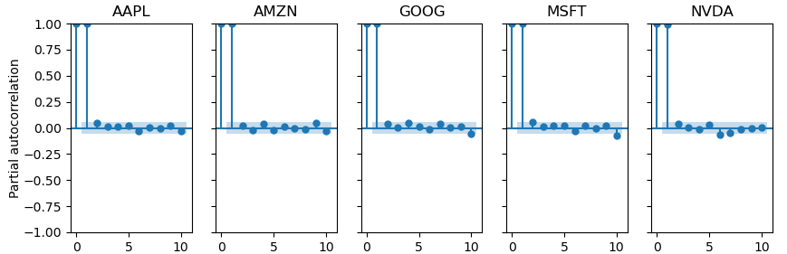
Long Short-Term Memory Networks
What are LSTMs?
LSTM networks are a type of recurrent neural networks, which contain cycles within the network activations to store contextual information. They take a sequence as input, making them appropriate for time series data.
A LSTM unit is comprised of a cell and three gates for input, forgetting, and output. The cell is for memory, and the three gates regulates the memory.
Implementation
Choose parameters: from partial autocorrelation plots, a look-back window of 5 days was selected.
We used two LSTM layers, each with 100 units.

Slide 12
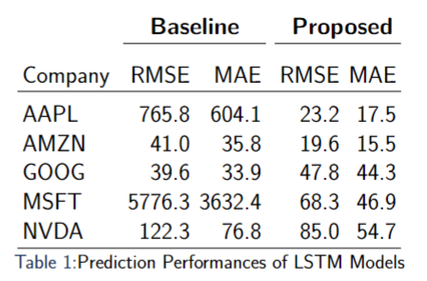
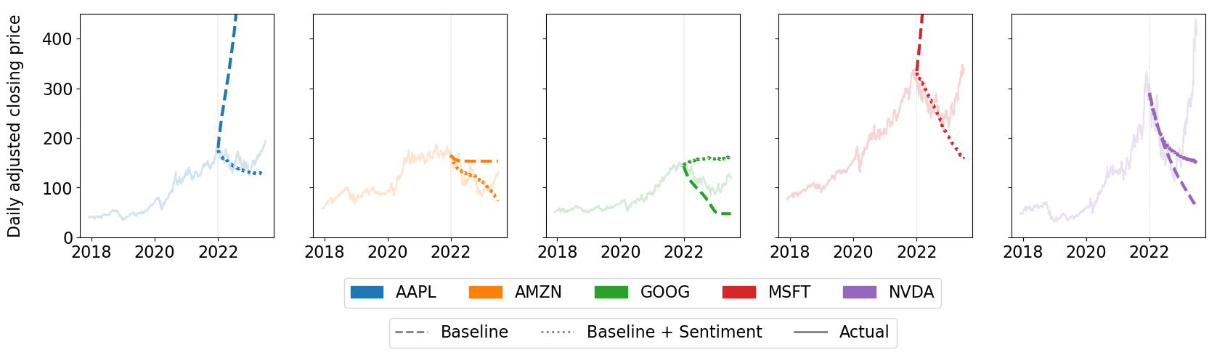
Long Short-Term Memory Networks
Model Fitting
Fit the model in Keras:
Baseline model: univariate LSTM
The input is the previous 5 days' stock prices
Proposed model: multivariate LSTM
The inputs are the previous 5 days’ stock prices, daily sentiment score and headline volume
Evaluate model on test data.
Notes:
took about 2 minutes to fit per model. run on google colab.

Slide 13
Conclusion
Used web-scraping and performed sentiment analysis to transform large qualitative news information into quantitative measurement
Implemented multivariate LSTM to tackle massive sequential stock prices prediction
Our results indicated that by including qualitative news data as an input does significantly improve the prediction of stock price trends

Slide 14
Thanks

